Slide 1
Design Review
Requirement Phase for caCORE Release 3.1
Proposed new features
Formbuilder
October , 2005
Prepared by Oracle Corporation
(Shaji Kakkodi)

Slide 2
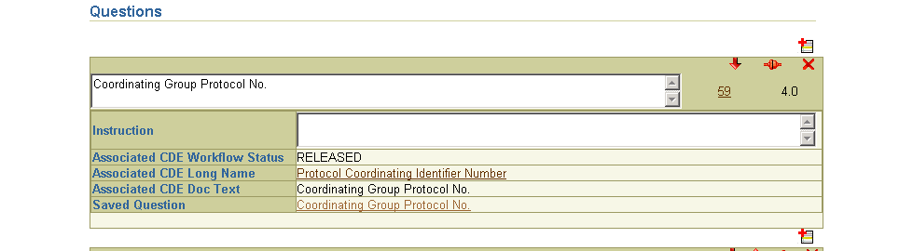
Specifying a Question
Current Implementation

Slide 3
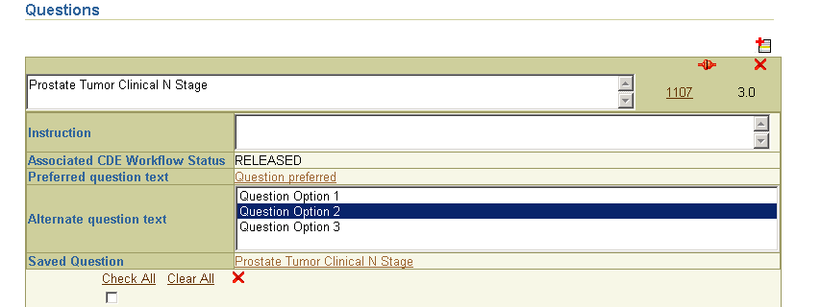
Specifying a Question
Question text: Use of Reference Document of type “Preferred Question Text” and “Alternate Question Text” of the associated CDE as the question text

Slide 4
Specifying a Question
Text field will not be editable
Default is “Preferred Question text” when CDE is added to the form.
Issue: What if there is no “Preferred Question Text”?
  Default to “Long Name” saved only as the Form’s question text?

Slide 5
Skip Pattern
Skip pattern stores the metadata about the navigation from one location(Source) to another location(Target).
Source location can be from a particular valid value or the End of a Form or Module.
Target location can be a Form, Module or a Question on the same Form or a different Form.
“Skip Pattern” can also have an instruction.
Validate skip patterns on a form
  Skip pattern is invalid if its Target does not exit

Slide 6
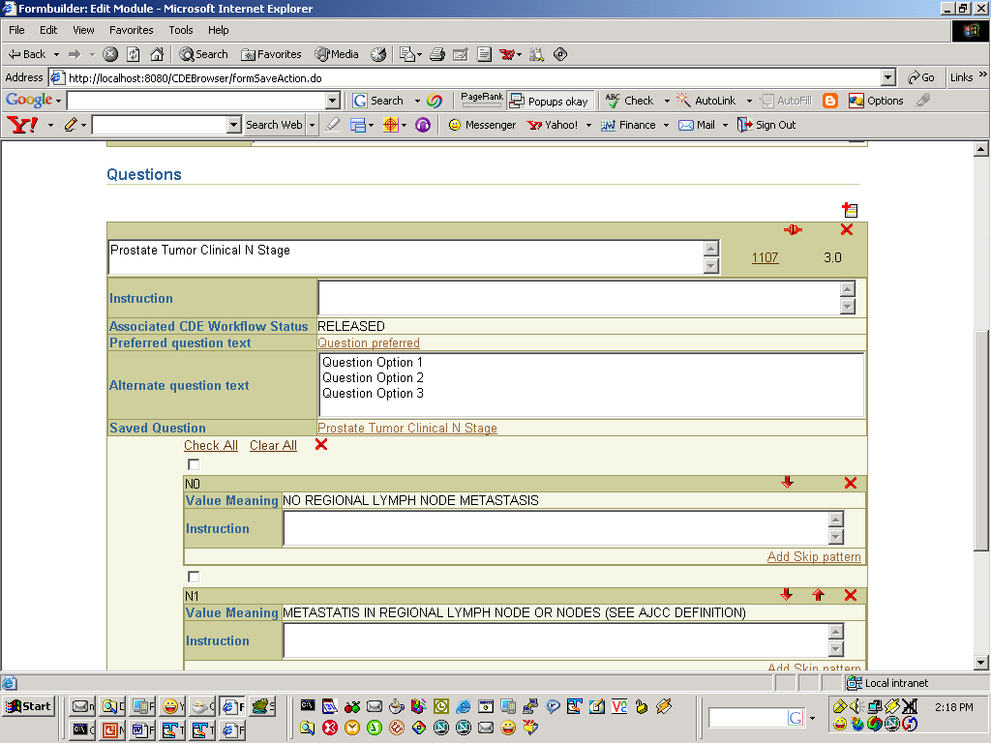
Module Edit Screen
Add skip pattern

Slide 7
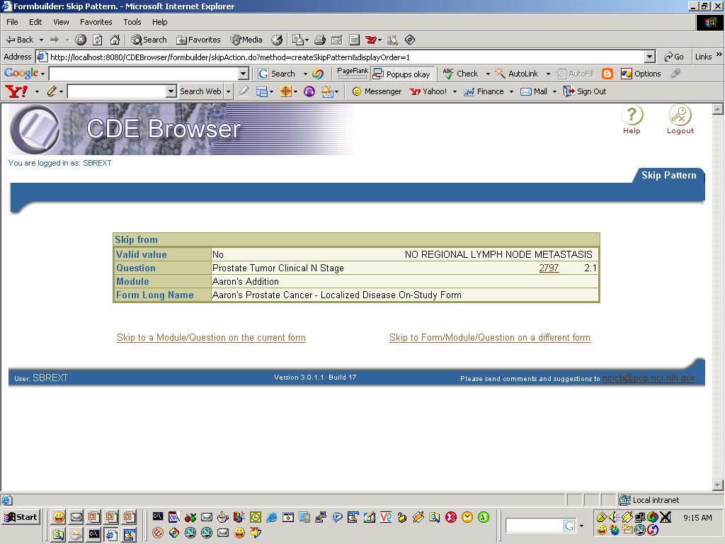
Skip where?
Skip where?

Slide 8
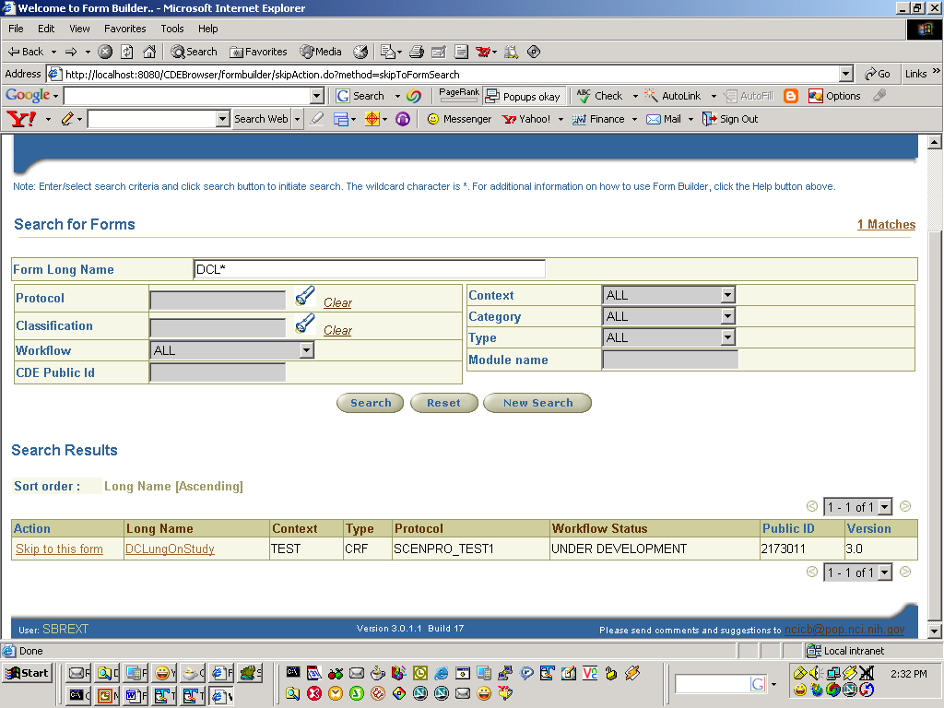

Slide 9
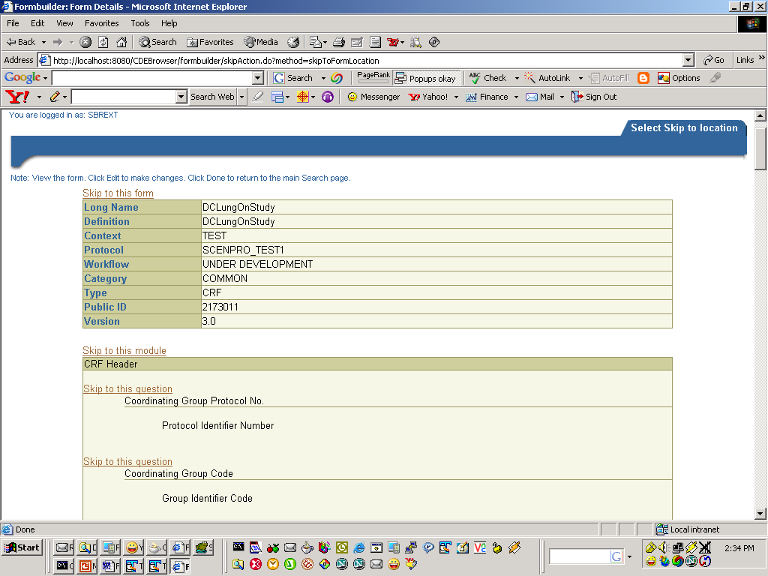
Skip to top of this form
Skip to this module
Skip to this Question

Slide 10
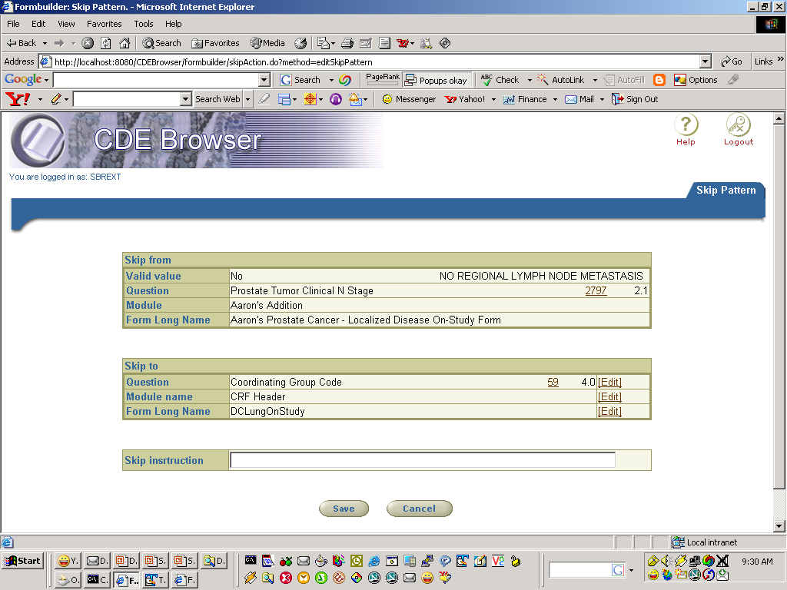

Slide 11
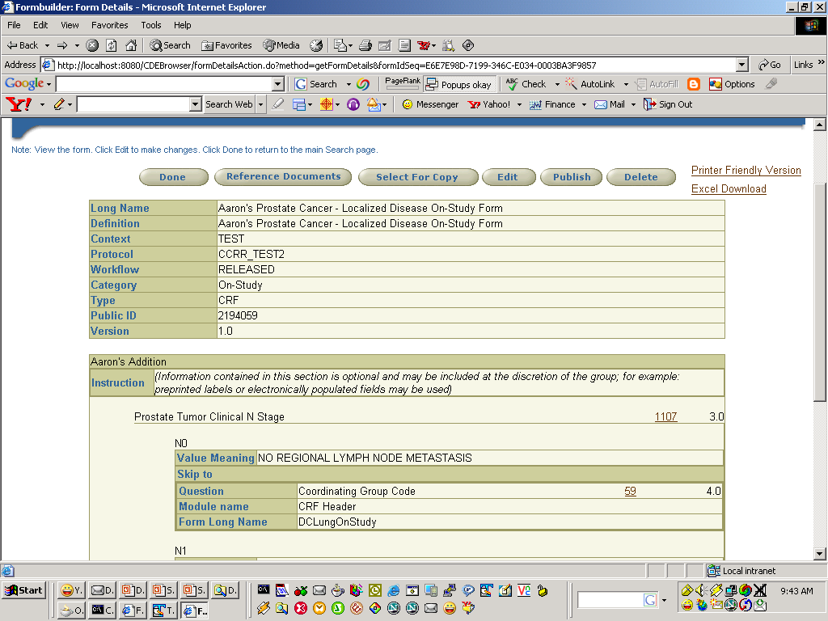
Adding a Skip Pattern to a Valid value
View Form Screen
View Form Screen

Slide 12
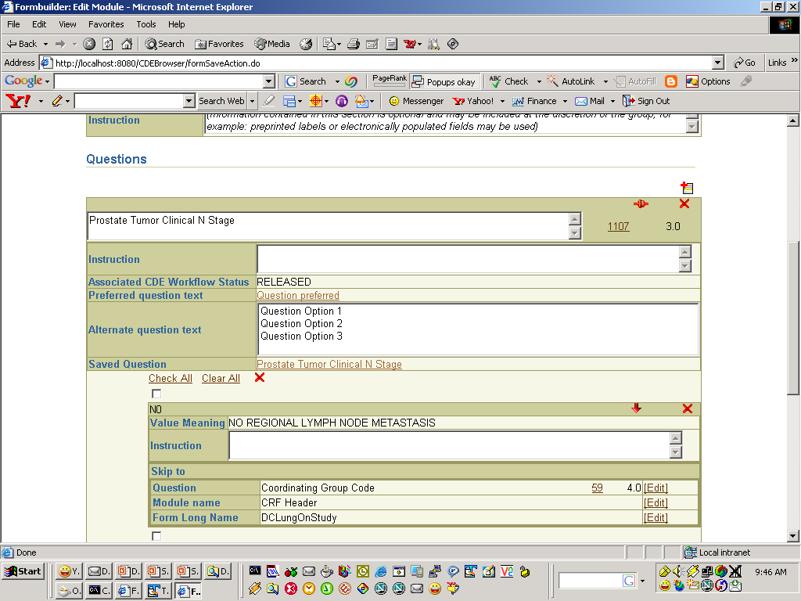
Adding a Skip Pattern to a Valid value
Edit Module Screen

Slide 13
Adding a Skip Pattern to a Valid value
Skip-from information will be displayed at the Target location.
When Target is deleted skip pattern on the source will be deleted automatically.
There can be only one skip Target per Source
A location can be Target from multiple Sources

Slide 14
Copy Module
During Form edit/create process
  Search for a module on the same/different form
  Copy and paste the module into the form
  Will have the ability to add multiple copies of the same module
  Not a “reuse” – if original module is changed, the ‘copied modules’ will not be changed.

Slide 15
Subset Value Domains
Subset Value Domains: Create subsetted Value Domains/CDEs
  Create a subsetted VD if one does not exits
  Create Parent child relationship
  Create new CDE
  Create Parent child relationship
  Question associated with new CDE
  New VD/CDE is created in the same context as Form
  Question associated with the new CDE

Slide 16
Miscellaneous
CDE UI Metadata: Add/Display UI Metadata attributes
Value Domain: Display VD attributes for non-enumerated
  Data type
  Format
  Max length, Min length
Classification
  Ability to Classify all CDEs on Form when classifying a form.
  Enhance classification LOV
    Add search criteria “type”
    Change Column ordering to
      CS Long Name, CS Context, WS, CSI Long Name, CSI Long Name
Label Change: Change Preferred Name to Short Name and Long Name to Preferred Name

Slide 17
Miscellaneous
Derived DataElements: Display derived data element information in CDE Details.
Form version: User can version a form
  All attributes are copied.
  Default Workflow status is “Draft New”
Context Search: Allow users to search more than one context at a time.
Integration: Curation tool and Sentinel tool
  If no matching CDE exit create new CDE
  Option to Set alert for modification to CDEs on the Form - need to indicate whether or not an alert already exists for the form so duplicates are not created.
  Alert be set when the “Copy” is performed that if the original form was changed, an Alert would be sent to the form owner that copied it. Delete the alert in case the Form Owner decided not use the module…

Slide 18
Miscellaneous
HL7 Message: Generate HL7 message for a form.
  Issue: the HL7 eDCI project must get approval for the message format by November 18th (Detail design Freeze)

